Slide 1
Predicting Playtime on Steam
Taha Ahmad
Notes:
Hello everyone, I’m Taha Ahmad and I’m going to talk a little about the statistical analysis I did on user ratings and playtime on Steam.

Slide 2

What is Steam?
Notes:
To start off with, let’s define what Steam is so my presentation can actually be understood.
Valve corporation’s Steam is the most popular store front for digital computer games. Nearly every video game that is released these days which supports being played on computers will be listed for sale on Steam. Valve also provides robust API access to stats regarding both players and games for developers to utilize. This makes it ideal for gathering data on sales and engagement about video games.
I utilized the Steam Spy API which collects data directly from the Steam Web API to gather the top 100 games which have the highest count of players in the past two weeks.

Slide 3
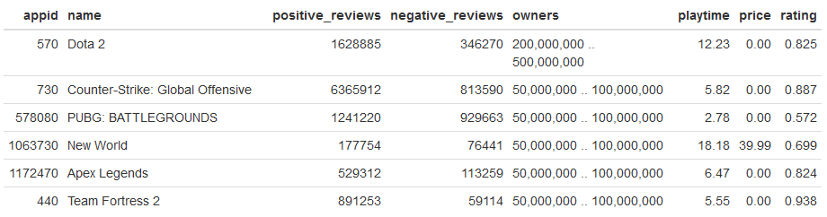
The Data
Notes:
With this data we have a variety of information about the applications such as the amount of reviews, the amount of owners, the price of the games, and the playtime.
In R I had processed this data to calculate the user rating, factorizing the owner category, and converting playtime to hours.

Slide 4
The Question
Considering the top 100 most played games in the past 2 weeks, are the user ratings, reported by Steam, related to median playtime?
Notes:
With this data, I wanted to try to find out how to best predict playtime with the information we have. More specifically, I believed that user ratings would be a good predictor for playtime. Thus we have our research question:
Considering the top 100 most played games in the past 2 weeks, are the user ratings, reported by Steam, related to median playtime?

Slide 5
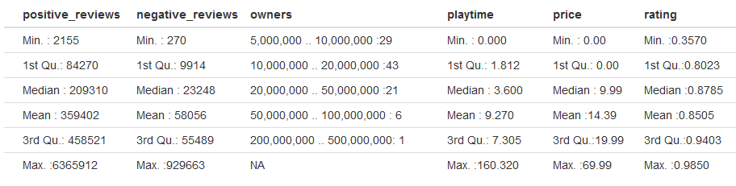
Summary Statistics
Notes:
I began data exploration with looking at the summary() of the whole dataframe. Looking between the data as a whole, we notice that the means are almost always skewed away from the median. This is especially prevalent in the reviews and the playtime with strong rightward skews. This means that there are large outliers within those categories that we might want to deal with to prevent our regression model from not being generalizable.
However, if we compare the positive and negative review count categories with our transformed rating category, we can now see that the skew is much less noticeable with only less than a 2 percent difference between median and mean. Meaning we should use this category over the other two in our model.
Evaluating our response variable of playtime, we can see something odd right off the bat. There are games with no playtime within the top 100 most played games of the past two weeks as our minimum. Although, this is possible to be accounted for by many users launching the games and closing them right away leading to many users counted as “playing” a game, it should not be possible for these games to eclipse those with actual playtime recorded in them. This anomaly seems more likely to be an error in the data and should be dealt with as well.

Slide 6
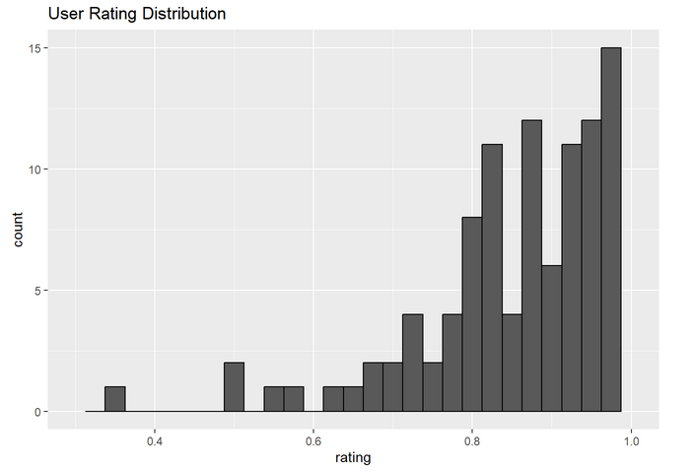
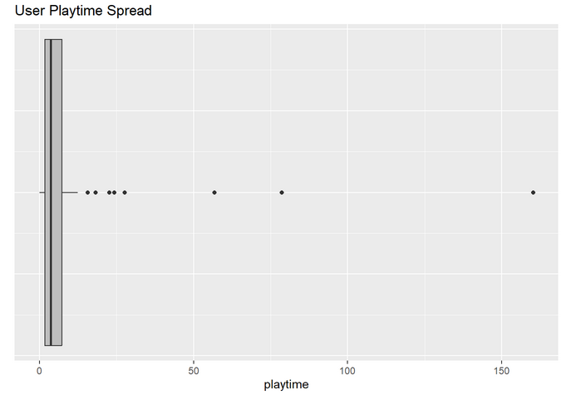
Distributions
Notes:
Taking a closer look into some of these distributions that we believe are off, in the case of user ratings we have 5 outliers towards the left where despite the user ratings being low the game still manages to find itself on the top 100 most played. Here we will consider pruning the outlier with a user rating of less than 0.4, as it is completely disconnected from the rest of the user ratings. Thus not being a good input to take for a regression model.
In the case of user playtime, we have a boxplot to show how ridiculous the outliers are towards the right. it simply doesn’t make sense that a game shared between millions of players would have a median playtime of 150+ hours within two weeks. That’s close to a whole week’s worth of time, including nights, just playing the game. Thus we want to remove these outliers.

Slide 7
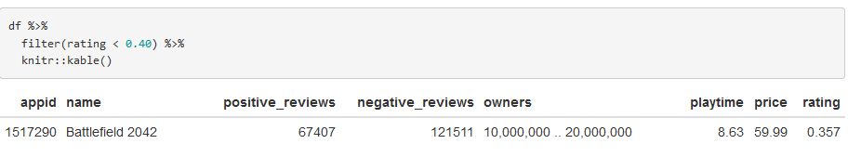
Outlier Removal
Notes:
Before removing the outliers, I did a bit of analysis on why the outliers were there and if it made sense to remove them. For example, our outlier for rating: We can see that the game is Battlefield 2042, and now the outlier makes a little bit more sense. The game was supposed to be a major and solid release for the Battlefield franchise, but ended up releasing in a very poor state regarding performance, gameplay, and bugs. Thus, it was bombarded with many negative reviews immediately after release and the reviews never recovered. Despite that, updates over time have led to a state of the game that facilitates a healthy population of users.

Slide 8
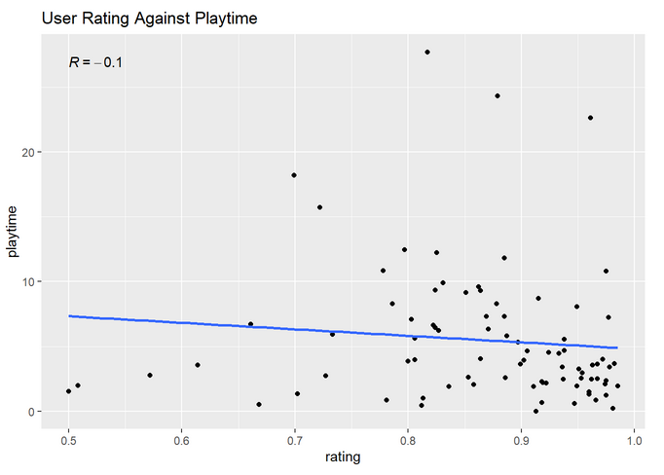
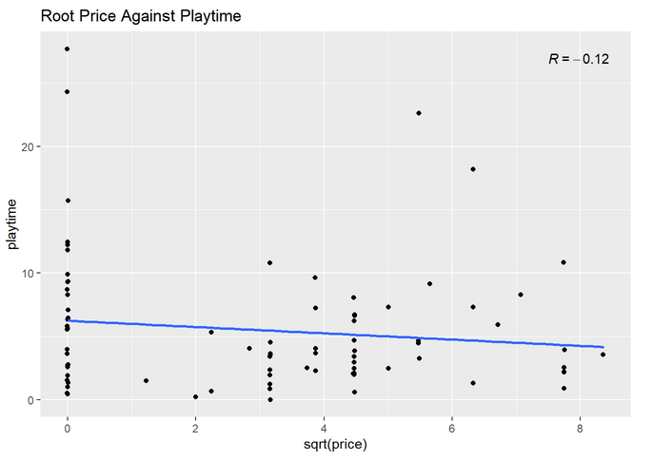
Scatterplots
Notes:
Going back to visualizing our data, we build a scatter plot for user rating against playtime. The results are not promising with a correlation of -0.1 which suggests little to no negative correlation. We can also notice that the variance of playtime changes as the rating increases. Additionally, there are some outliers with more than 20 hours of playtime present as we have accepted those as not being too extreme.
We end up transforming our price variable to the root of price in order to get a better correlation here, ending up with a still very weak correlation of -0.12. However, it was better than the non-transformed correlation of -0.065.
Looking at both of these graphs you can see that neither are particularly linear, which will definitely pose a problem for creating a linear regression model in regards to assumptions of linearity.

Slide 9
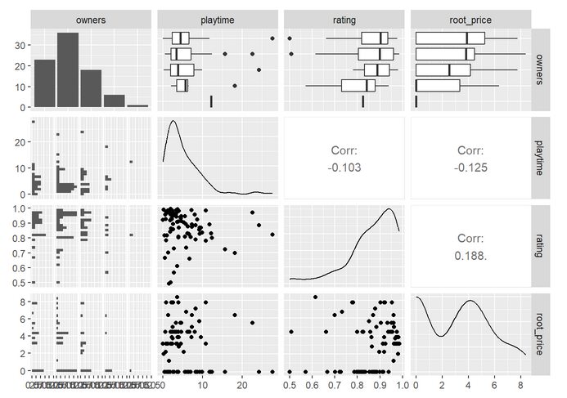
Pair Plots
Notes:
We’ll take a look at the pair plots for determining if we have colinearity between variables. As we have no correlations above 0.5 between variables, we can consider there being no colinearity here. However, as we saw before there isn’t anything that correlates particularly well with playtime either.

Slide 10
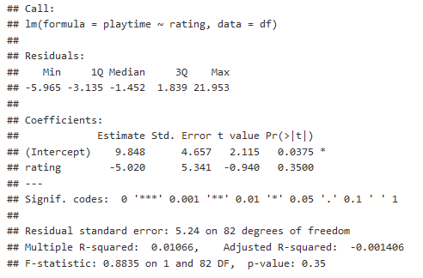

Simple Linear Regression
Notes:
We first tackle our research question on determining if the user ratings, reported by Steam, are related to median playtime with a direct simple linear regression model.
Our regression model on the right can be interpreted as for every percentage point the rating goes up, the playtime goes down by .05 hours with a baseline of 9.85 hours played for a game with a 0% user rating. Oddly enough, we seem to have a negative relationship between playtime and a game’s user rating too.
Next we can examine the information regarding the coefficients. The standard error we have is barely smaller than the estimate of the rating coefficient, which is not indicative of a good model’s variability. Additionally, we have a small t-value that leaves the probability of any linear relationship being from chance of 35.0%.
Finally we’ll take a look at the goodness of fit with the multiple R-squared value. At 0.0107 we know that the model accounts for just 1.07% of variation in playtime based on the user rating. All signs so far point to our model not being fitting in this case.

Slide 11
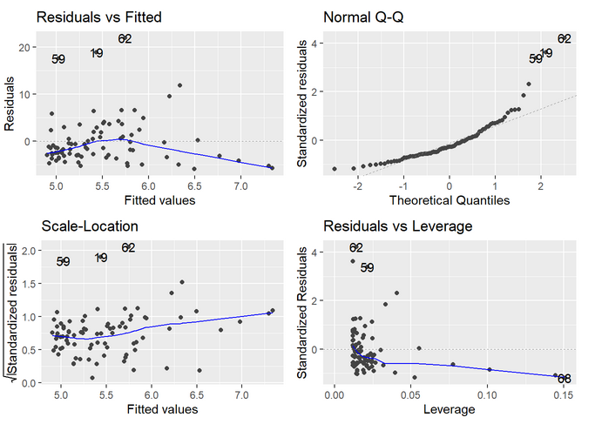
Simple Regression Assumptions
Notes:
Let us take a look at the individual residuals and what they tell us with the model.
Looking at the residuals vs fitted plot we can see that our data is not distributed well. The residuals are concentrated towards the left side and begin to fan out as we move to the right. These deviations mean that the model is not a great fit for our data as we have violated homoscedasticity.
Generating a qq plot of our residuals reinforces the idea that our residuals do not seem to be normally distributed, and thus our model is not a great fit for the data. Both the lower and upper residual data deviates from normality, with the deviations towards the top quantiles being especially egregious. Thus, we have violated the assumption of residual normality.
Going back to our scatterplot, the linearity between playtime and rating is dubious. The correlation is low and the spread is more of a cone shape than a line. We will consider the assumption of linearity violated as well.
The one assumption that we have not violated here is independent observation as what games the different users will be playing is not going to be dependent on another game.
From our analysis here, we have come up with a simple linear regression model that was not appropriate for our data. As we were unable to create a good model just by using user rating and median playtime we are able to answer our research question here:
No the user ratings, reported by Steam, are not related to median playtime based on creating a regression model from the data.

Slide 12
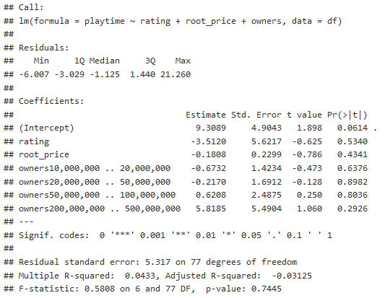
Multiple Regression
Notes:
Although our research question is answered, we still have the data to attempt to generate some type of relationship between our other predictor variables and median playtime. We will now create a multiple regression model to see if we can make a better model including the other variables.
Our generated model as shown tells us with its equation: With a y-intercept of 9.3 we are told that a game would have close to 9.3 hours of median playtime if there were no reviews at all.
The rating coefficient tells us that for every percentage point a game is rated, the median playtime decreases by 0.035 hours. However, our p-value is not significant at 0.534 which tells us rating is not a good indicator for playtime.
The root_price coefficient tells us that for every root dollar a game costs, the median playtime decreases by 0.181 hours. Yet again, our p-value at 0.434 is not significant which means root_price should not be used to determine playtime.
For each owner coefficient we know that if the game falls into one of these four categories of the amount of owners, it will either increase or decrease the median playtime in hours by the coefficient. However, none of the coefficients have a significant p-value. Meaning that these changes could very well be because of random chance.
Looking at the goodness of fit with the adjusted R-squared value. At -0.0312 we know that the model has taken so high of a penalty from our extra variables without gaining any benefit, that randomly guessing might as well be better.

Slide 13
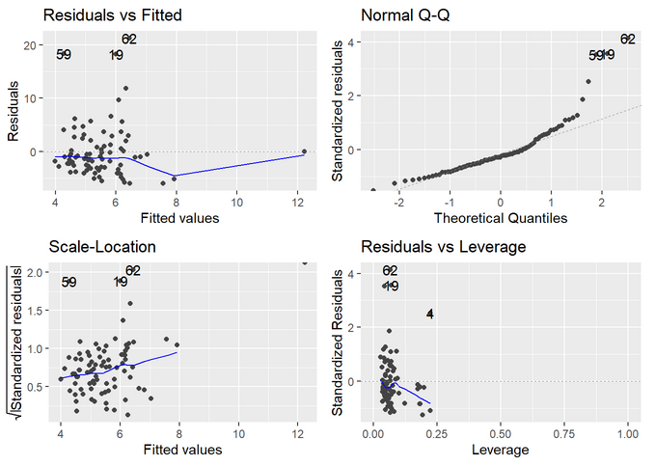
Multiple Regression Assumptions
Notes:
Looking at the residuals vs fitted plot we can see that our data is not distributed well. The residuals are concentrated towards the left side and begin to fan out as we move to the right again. These deviations mean that the model is not a great fit for our data as we have violated homoscedasticity.
Generating a qq plot of our residuals shows that our residuals do not seem to be normally distributed, and thus our model is not a great fit for the data. As the upper residual data deviates from normality quite a bit. Thus, we have violated the assumption of residual normality.
Going back to our pair plot, the linearity between playtime and rating is dubious along with root_price and rating. The correlation is low and the spread is more of a cone shape than a line in both cases. We will consider the assumption of linearity violated as well because of these.
We retain an assumption that we have not violated, independent observation as what games the different users will be playing is not going to be dependent on another game.
The final assumption we check for multiple regression is colinearity. Going back to the pairplot we see that between predictor variables there is low correlation, thus we pass this assumption check.
From our analysis here, we have come up with a multiple linear regression model that was not appropriate for our data. The adjusted R^2 was in the negatives and none of our coefficients were statistically significant. Additionally, three of our assumptions have been violated. In the end, this model was not much of an improvement over the previous model if at all.

Slide 14
Conclusion
The user ratings, reported by Steam, are not related to median playtime based on creating a regression model from the data.
Notes:
After going through our regression analysis we can answer our research question with our data. The user ratings, reported by Steam, are not related to median playtime based on creating a regression model from the data. This is because within our regression models created, user rating as a dependent variable is never a statistically significant predictor of median playtime.
Knowing this might be useful to any future researchers who are interested in what sort of variables increase player retention and playtime. Despite, not being able to create a useful model we now know that in the future someone attempting the same analysis should attempt different methods to do so.
We were limited with the amount of data we had in both the variables used as predictors and the sample size as a whole. Any further research should be attempted on a larger dataset, or with different methods of transforming the existing data.

Slide 15
References
Yun Yu’s Harvard post was used for the introduction assumptions on Steam’s popularity.
Steam Spy was used for its API data.
PC Gamer contains more information on the outlier Battlefield 2042.

